Slide 1

Python Online Movie Ticket Booking
1: Shivam Gupta :- 20104110
2: Rupesh Mishra :- 20104100
3: Yashab Mahimi :- 20104026
4: Meet Bohra :- 20104057
Project Guide
Prof. Charul Singh

Slide 2
1. Introduction
Problem’s Identified :
The traditional way of booking the ticket for the movie is the customer need to go to the specific theatre where the desired movie was playing and stand in long queue and buy the ticket which consumes lots of time.
Proposed Solution :
View the list of movies present
View the trailer of the movie
View the list of theater based on show
Availability of seats
Book the ticket for specified movie from your home.

Slide 3
2. Objectives
To provide hassle free services to the customers.
To provide filter reports on seat availability, shows.
To increase efficiency of booking.
To manage the payments for the customers.
To generate reports on shows, payments.

Slide 4
3. Scope
Can save the customer’s valuable time
Provide customer’s with hassle free and safe payment option.
To provide customer’s with detailed information about availability of seats and time of shows.
Any institute/company can book tickets for students/clients and special discounts will be provided to them.

Slide 5
4. Feature /Functionality
Feature 1 :
We have added suggestion’s which will help the customer to pick movies easily based on his taste
Feature 2 :
We have tried to make a save and trustable payment options for the customer .
Feature 3 :
We are looking to add the information IMDB rating’s for the movies which can help the customer to classify movies better.
Feature 4 :
We have try to make the app better and user friendly so that our customer never face any issues

Slide 6
5. Outcome of Project
User can register
User can login and book tickets
User can search for the movies
User can even view the trailer and can decide whether to book or not
User can search for the movie they want to watch
Users will be provided with E-bills which will help to save paper
Users will be provided with the information like location, time of the show etc

Slide 7
6. Technology Stack
PROGRAMMING LANGUAGE :- Python
IDE :- IDLE
DATABASE :- MYSQL

Slide 8
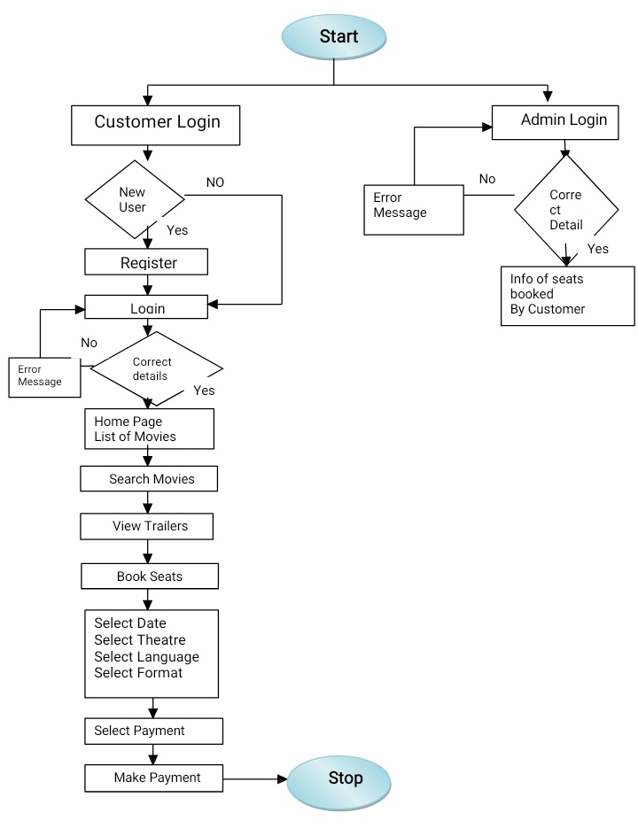

Slide 9
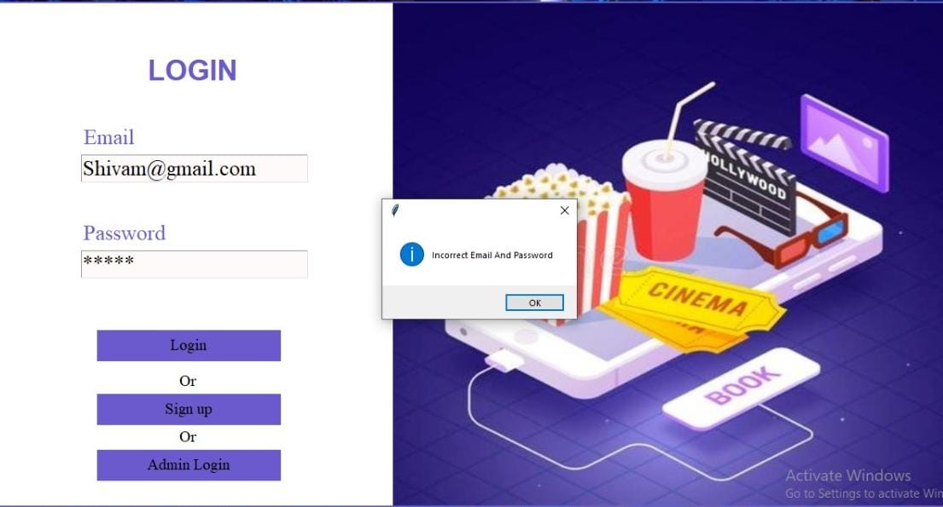
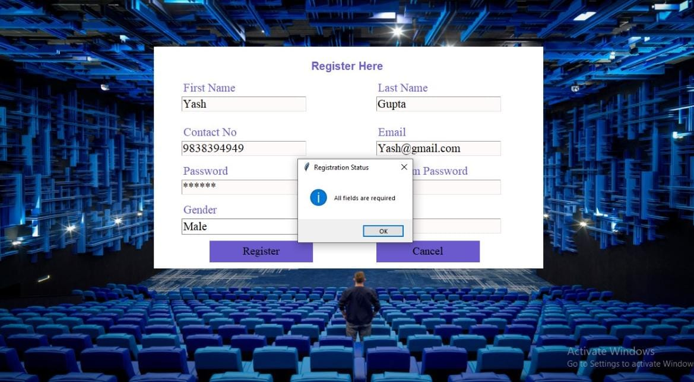

Slide 10
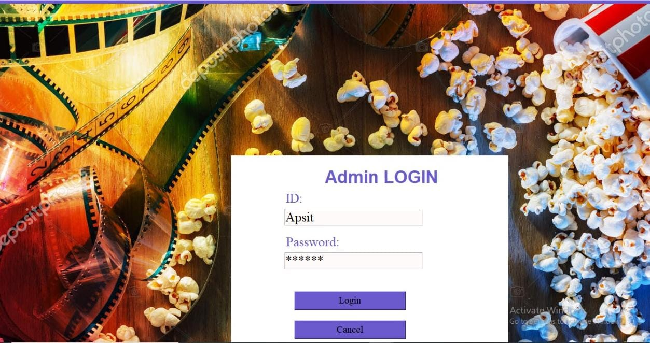
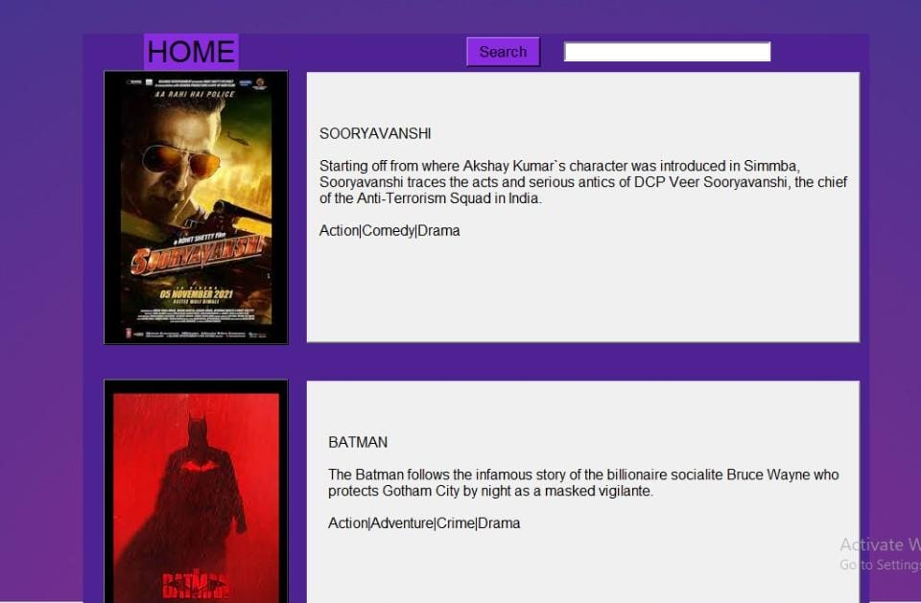

Slide 11
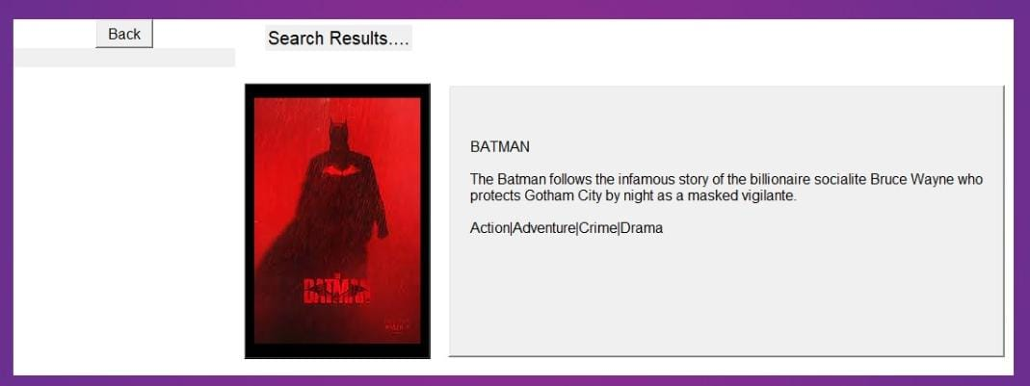
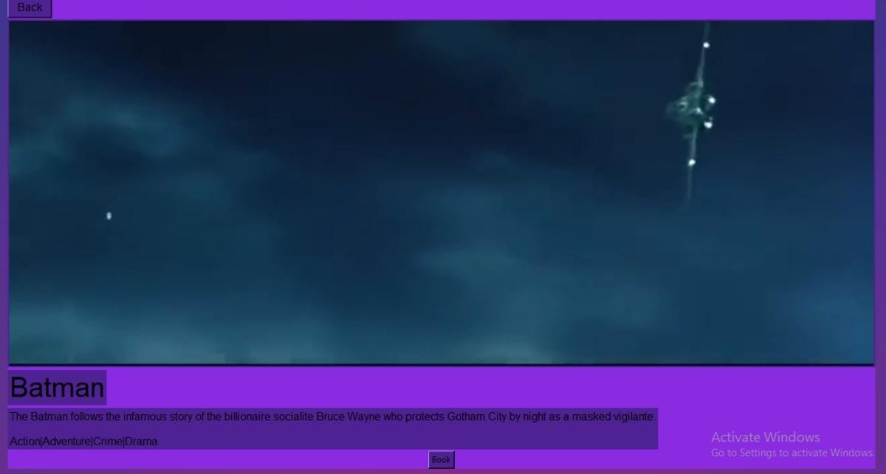

Slide 12
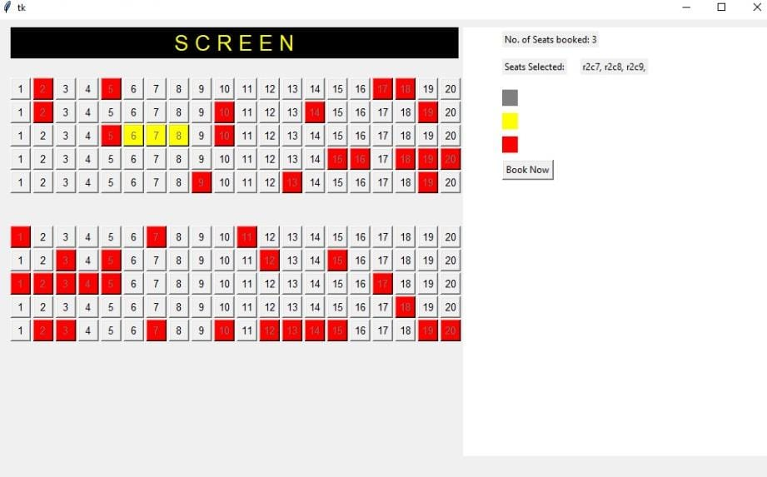
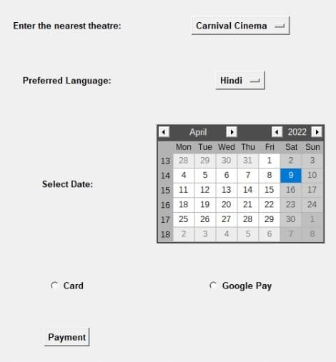

Slide 13
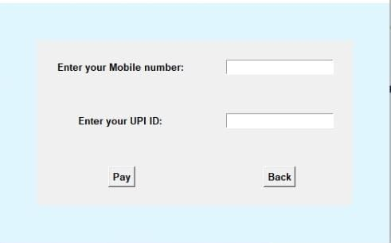
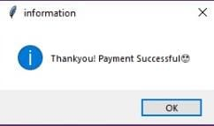
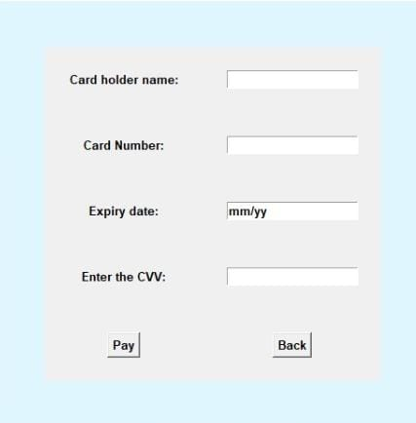

Slide 14
Conclusion:
In this project, we made to attempt to effectively introduce the concept of Online Movie Ticket Booking System already existing in the society . We also give a brief overview of the technologies used during the development of our proposed system. Through this the user will get the clear idea about how to select the particular movies they wanna watch, how to select the theatre, seats and atlast how to make payment while booking for the movie.
Notes:
Hs

